Slide 1
Introduction to Raspberry Pi
Ville Klar
Doctoral Candidate
Machine Design

Slide 2
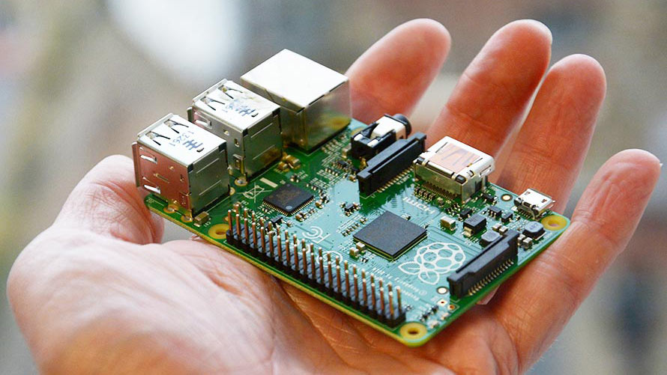
What is Raspberry Pi ?
Arguably the most popular single board computer (SBC)
Easy to get started with because basically every problem is documented
Add a computer with a OS to practically anything
NOTE: Do not expect it to perform as well as your laptop
Support for a vast array of peripherals (thanks to the Linux kernel)
USB devices, networking, displays, cameras, audio etc.

Slide 3

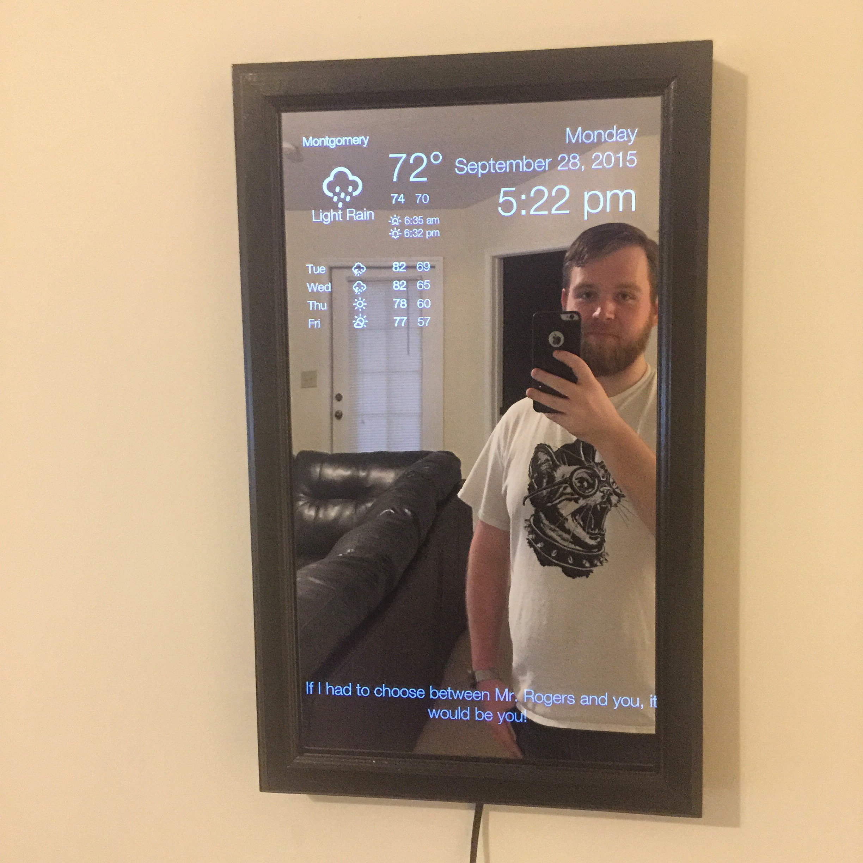
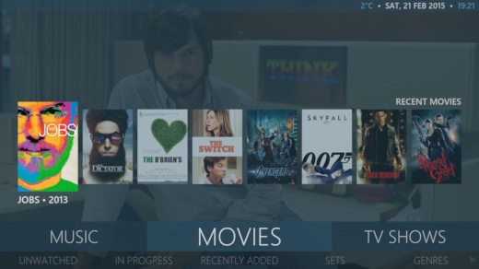
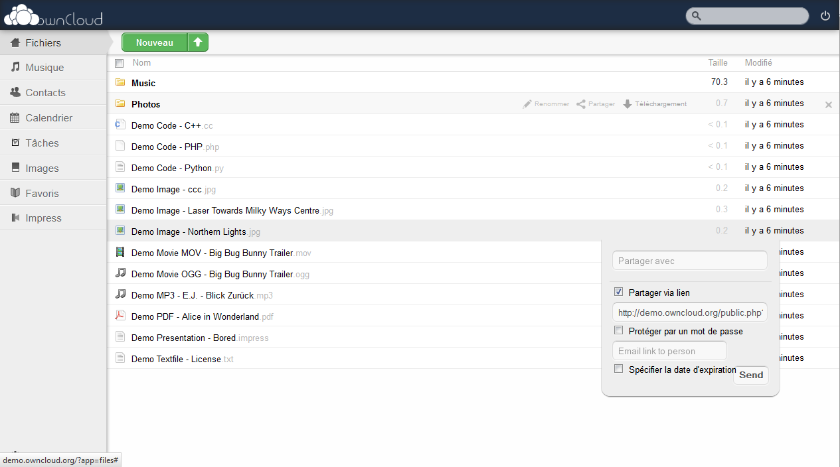
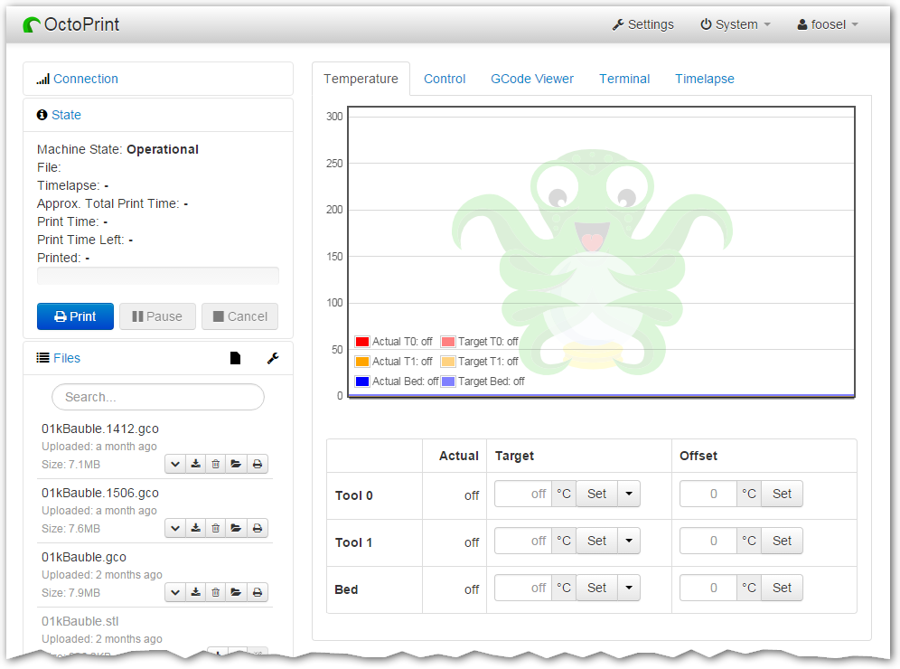
What can you do with a Pi? (not so cool)
https://learn.adafruit.com/pigrrl-2/overview
http://mymediaexperience.com/raspberry-pi-xbmc-with-raspbmc/
https://www.raspberrypi.org/magpi/magic-mirror/
https://vadelmapii.com/blogi/yllapida-omaa-dropbox-kloonia-raspberry-pilla-kayttaen-owncloudia
https://github.com/foosel/OctoPrint

Slide 4
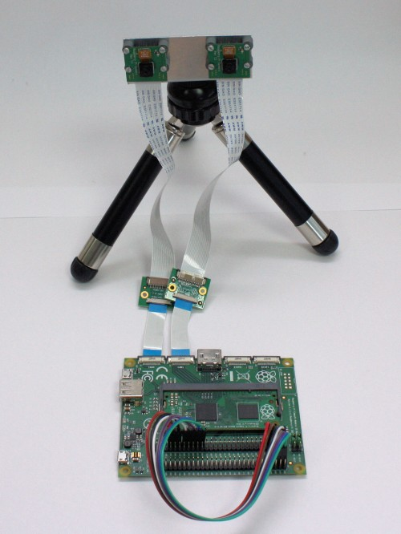

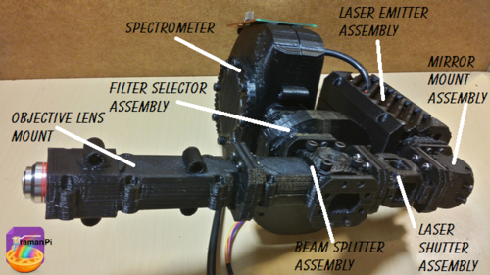
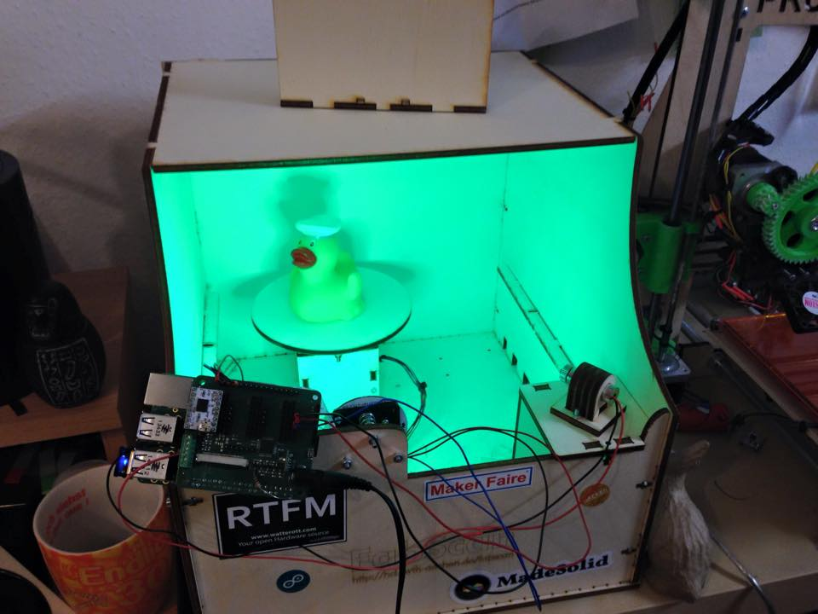
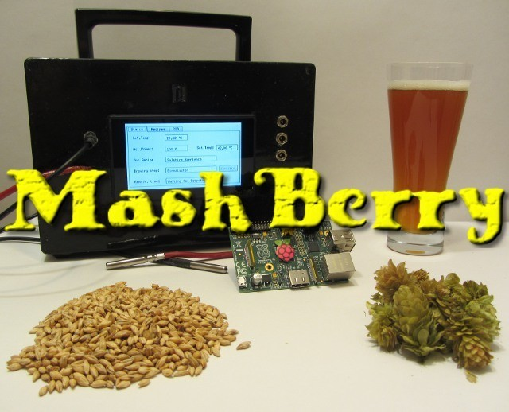
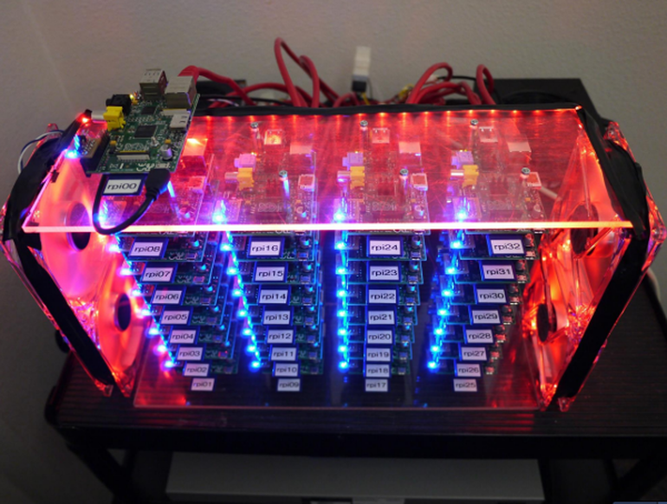
What can you do with a Pi? (cool)
https://hackaday.io/project/1279-ramanpi-raman-spectrometer
https://www.raspberrypi.org/blog/real-time-depth-perception-with-the-compute-module/
http://www.zdnet.com/article/build-your-own-supercomputer-out-of-raspberry-pi-boards/
https://hackaday.io/project/1269-mashberry-beer-brewing-with-raspberry-pi
https://www.raspberrypi.org/magpi/fabscan-pi-project-3d-scanning-for-all/

Slide 5
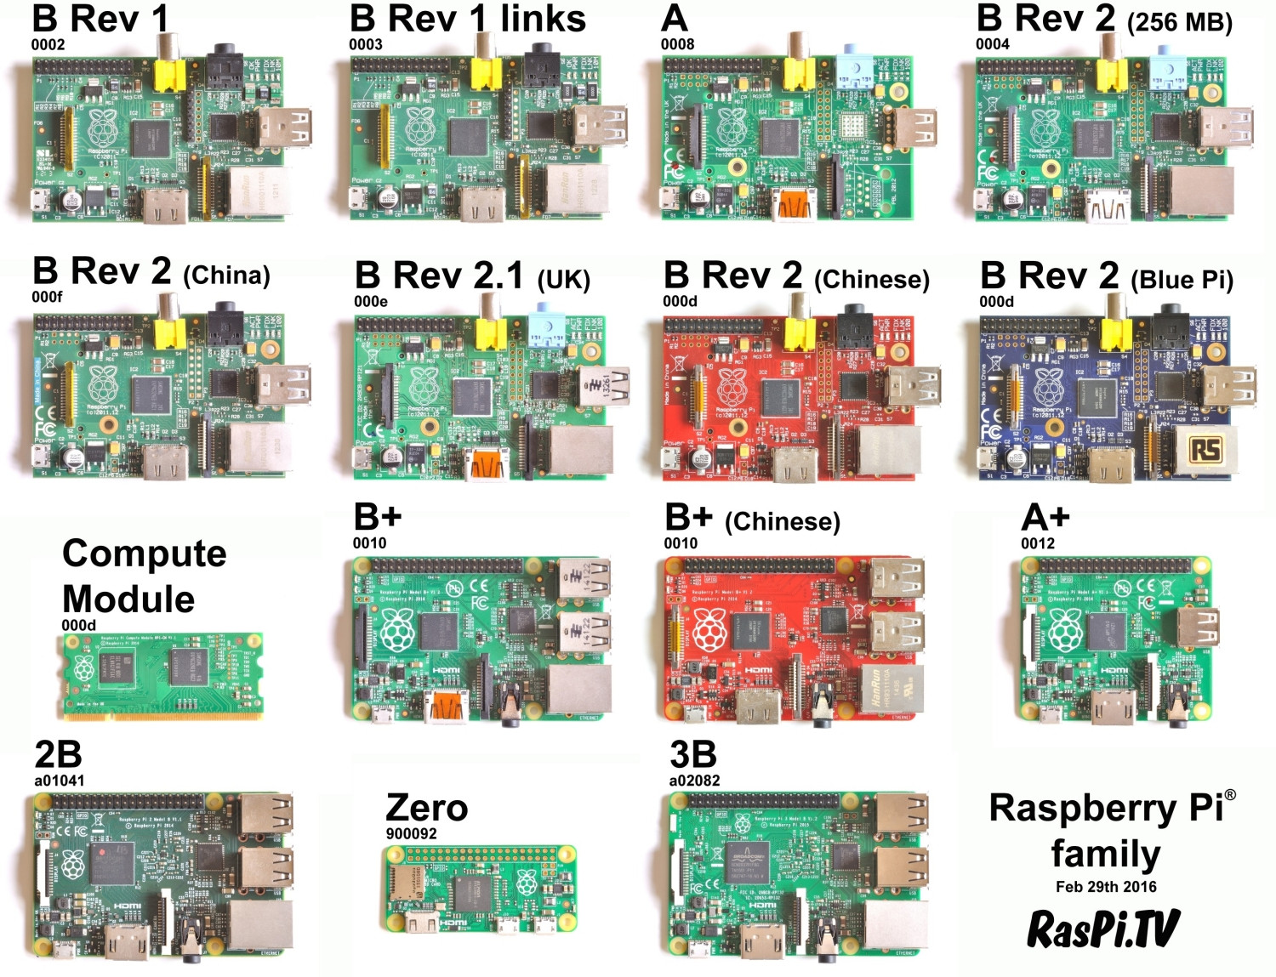
Raspberry Pi models

Slide 6
Raspberry Pi advantages and disadvantages
Cheap (price per performance)
Well documented
Availability
Also in terms of add-ons (HATs)
Versatile
Compact (especially Zero)
Scary linux (learning required)
Not real time*
No ADC (easy to add though)
PWM possible but limited frequency
* It is possible to install a RTOS on the Pi

Slide 7
Getting started
Install OS
Configure OS
Connect peripherals
Write software
Profit (?)

Slide 8

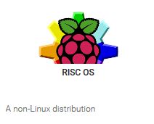
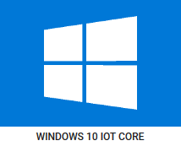
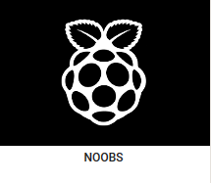



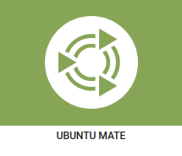

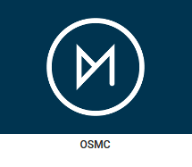
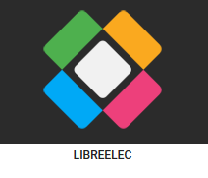
OS options
with Pixel or Lite

Slide 9
Installation process
Get SD card (micro on newer Pi’s)
Format to FAT32 (for example with SD card formatter)
Using NOOBS:
Download NOOBS (sd-cards with pre-installed NOOBS can purchased)
Unzip and copy all contents to SD card (takes a while)
Boot
Using a disk image writer:
Download the disk image (.img)
Write the disk image on the SD card (“hard drive”)
Windows: Win32 disk image writer or Etcher
MacOSX / Linux: Use dd (or image writer with GUI such as Etcher)
Boot

Slide 10
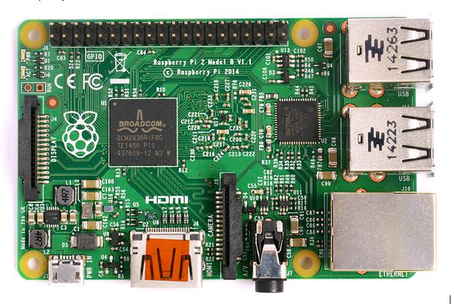
Connections
GPIO
MicroSD-slot
(underneath)
4x USB 2.0
Display connector
Ethernet
Micro USB for power (min. 5V/1A)
3.5mm Audio/Video Jack
HDMI
Camera connector

Slide 11
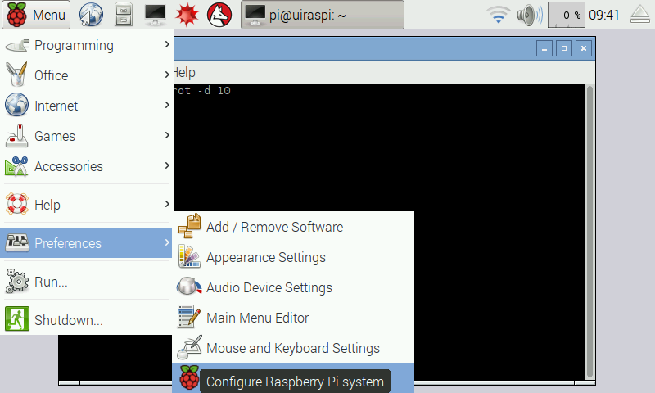
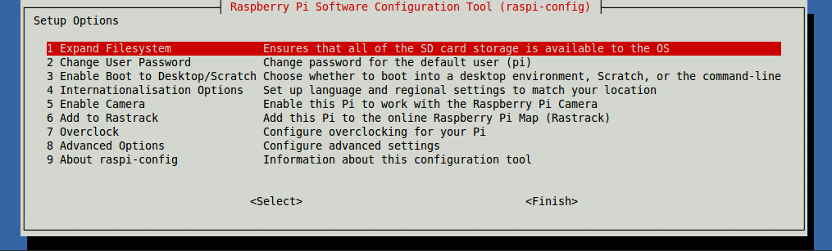
On first boot…
NOOBS installer has GUI (Raspbian recommended)
Boots into raspi-config (you can run it with “sudo raspi-config”)
Expand file system, change password and change keyboard layout, enable ssh etc.

Slide 12
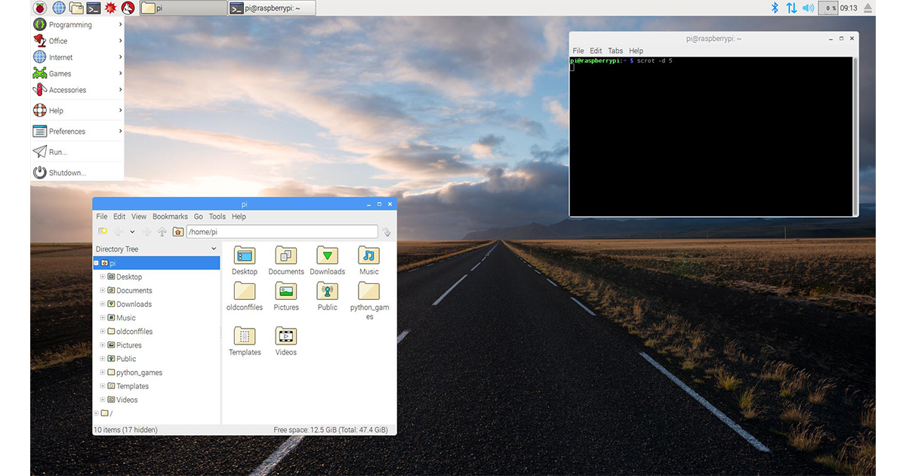
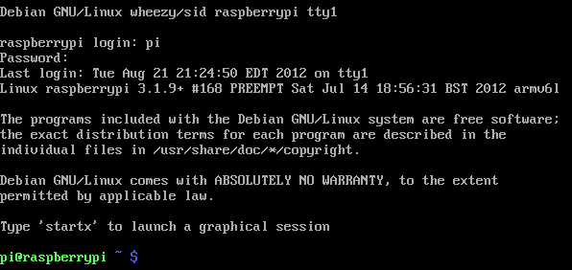
Terminal or Pixel
There are two options when booting: shell or Pixel desktop (graphical session)

Slide 13
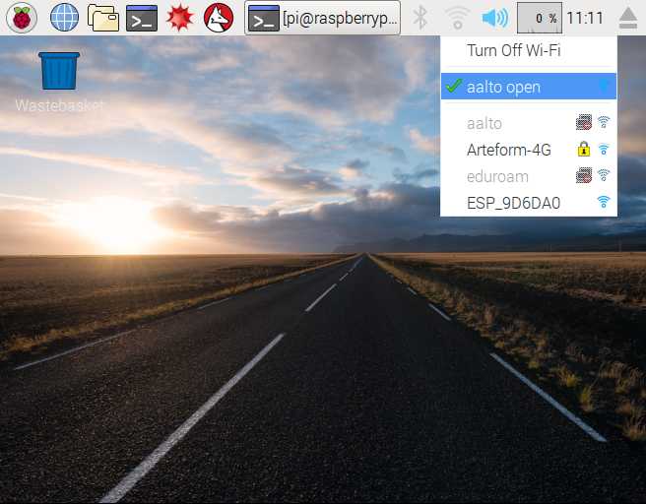
Connect to WLAN
In GUI:
Choose WiFi network and connect
Without GUI :
sudo iwlist wlan0 scan // scan for networks
sudo nano /etc/wpa_supplicant/wpa_supplicant.conf // open wpa_supplicant configuration
Add this to the bottom of the file
network={
ssid=“aalto open"
proto=RSN
key_mgmt=NONE
}

Slide 14
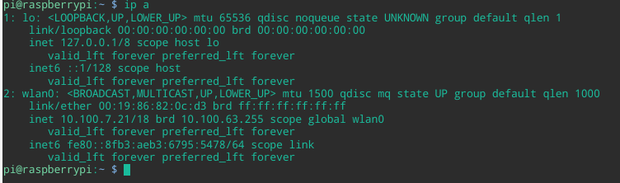
SSH
Secure shell = Easy way to remotely access a Pi
After connecting to a WLAN we need to find out the Pi’s ip address
Type ‘ip a’ in a terminal output is something like this
If you don’t have a monitor connected you can try to nmap the ip
If the Pi connects to the same router between boots, DHCP should give it the same ip
You can also configure a static IP
Local ip address

Slide 15
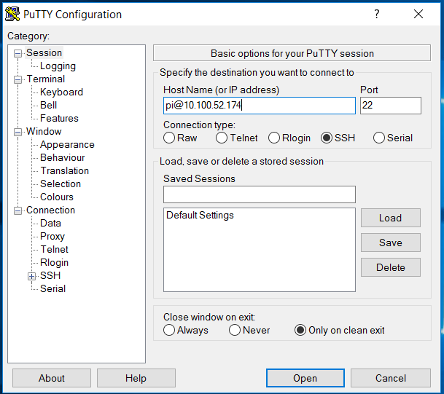
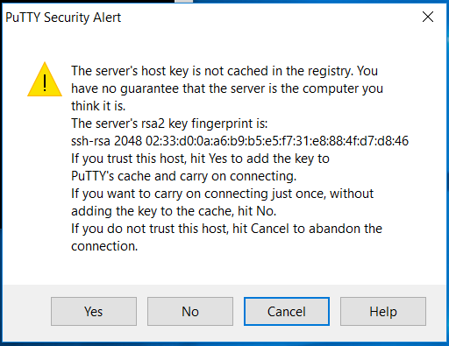
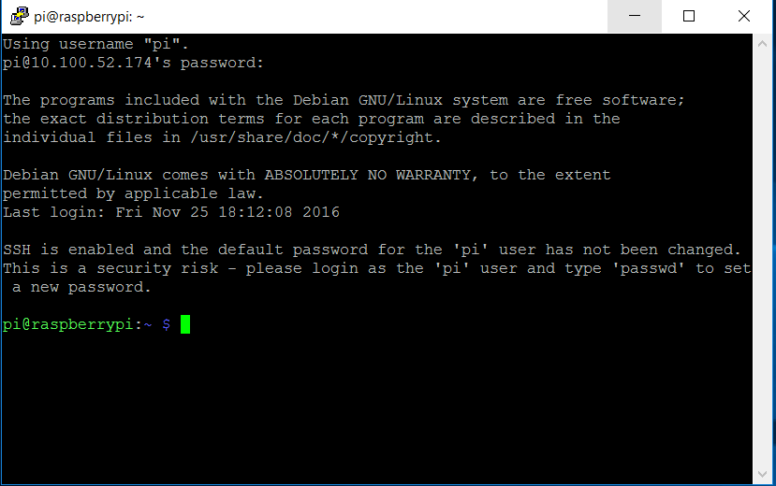
SSH
When you have obtained the ip-address you can access the Pi with e.g. Putty
If you can’t be bothered with IP addresses
You can also use hostnames
(doesn’t work with aalto open)

Slide 16
CLI / Shell commands
Command | Description
ls | List contents of current directory (folder)
cd | Change directory
mkdir | Creates a new directory (make directory)
sudo | Execute as super user (“admin” / root privileges)
cp | Copy (syntax is cp src dest)
mv | Move (syntax is mv src dest)
rm | Remove
./ | Dot-slash means execute
nano | Launch nano text editor
apt-get update | Update repository list (update list of links to software downloads)
apt-get install | Install a package
reboot | Reboots the system (run with sudo)
poweroff | Turns the Raspberry Pi off (run with sudo)

Slide 17
CLI/ Shell tips
Use tab to make the terminal autocomplete
Up and down keys to browse command history
Ctrl+c to kill a process, Ctrl+z to stop a process
Ctrl+r to search command history
Use ‘exit’ to close a terminal window
Type ‘man’ before the command to see it’s manual
Github repositories can be cloned (copied) with ‘git clone’
You can also open an sftp connection to the Pi to view and edit files & folders

Slide 18
Programming language options
Almost everything
C, C++, Python2/3, Javascript (node), Ruby, Lisp, Rust…
Most projects are either C or Python

Slide 19
GPIO Libraries
WiringPi (C and Python)
Blink example : http://wiringpi.com/examples/blink/
RPIO (python2/3)
PWM via DMA (up to 1µs resolution)
Bcm2835.h (C)
Pigpio (javascript / python/ C)

Slide 20
Demo 1: Video streaming
Installation instructions: https://github.com/jacksonliam/mjpg-streamer
Already installed in these Pi’s
Connect the Raspicam, make sure it is working with
raspistill -o cam.jpg
Run mjpeg-streamer with (first cd into ~/Software/mjpg-streamer/mjpg-streamer-experimental) :
export LD_LIBRARY_PATH=.
./mjpg_streamer -o "output_http.so -w ./www" -i "input_raspicam.so"
View the stream at http://localhost:8080 or with another computer (on the same network) at http://<IP-address-of-Pi>:8080
You can also use usb web cameras with mjpeg-streamer
There are many other options for streaming: clvc, gstreamer,
Use ctrl+c to kill the stream

Slide 21
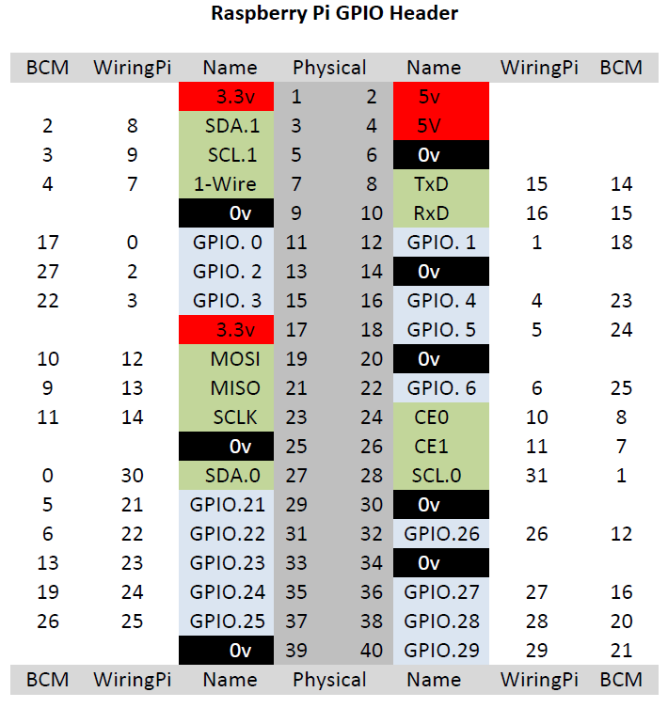
Demo 2: WiringPi
Open terminal
cd into ~/Software/WiringPi_Blink
Connect LED to gpio 29 and short lead to ground
We should put a current limiting LED but we can break the rules
Run blink with sudo ./blink
Try changing the pin to 28 (in the code) and run make to compile

Slide 22
Demo 3: Servo
Open terminal
cd into ~/Software/Python_Servo
Connect servo to gnd, 5V and GPIO 4
Run sudo pigpiod to start the gpio daemon
Run the python script with
python servo_demo.py
You can give another pin as an argument to the script e.g. python servo_demo.py 18
Try changing the speed of the servo

Slide 23
Tips
For (prototype) web servers: Python Flask
For GUIs: Tkinter (Python) or Qt (C++) or Node.js+Express.js
If you need e.g. read analog voltages and control motors → consider combining an Arduino with a Raspberry Pi
(Raspberry Pi commands Arduino board via serial (USB))

Slide 24
Links
Help videos (getting started)
Embedded Linux Wiki
Raspberry Pi Forums
Hackaday.io Raspberry Pi projects
Adafruit learning guides
Raspberry Pi subreddit

